Slide 1
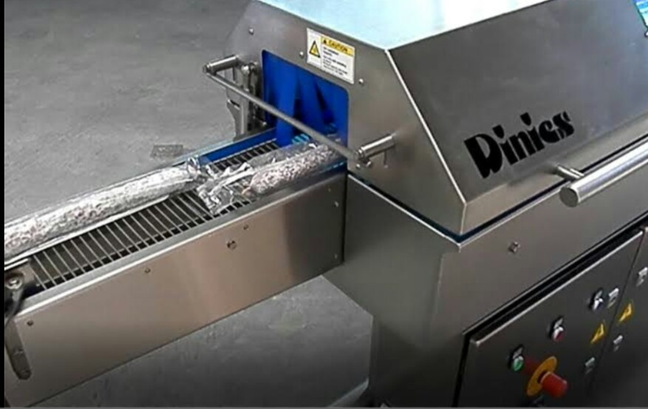
Products & Money Sanitizing Device

Slide 2
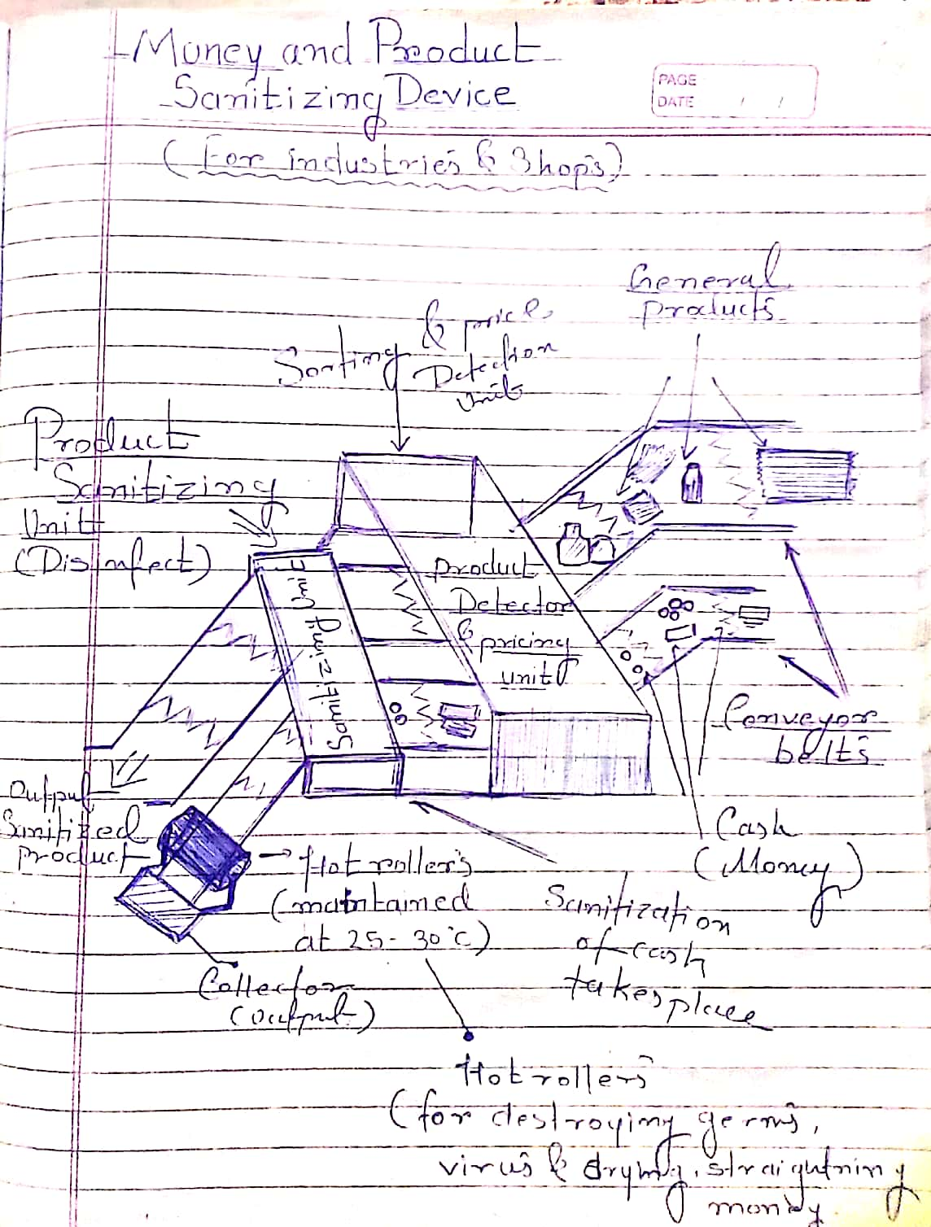
Money and Product Sanitizing device
A device which sanitizes various products and money and protects us from getting infected against various diseases like COVID-19. Our device covers wide range of products and intensionally made for operating in industries , shops , banks etc. It consist of very simple mechanism and can be implemented easily anywhere and requires low space and maintenance. Effectively kills or sanitizes product and money and thus protect lives.

Slide 3
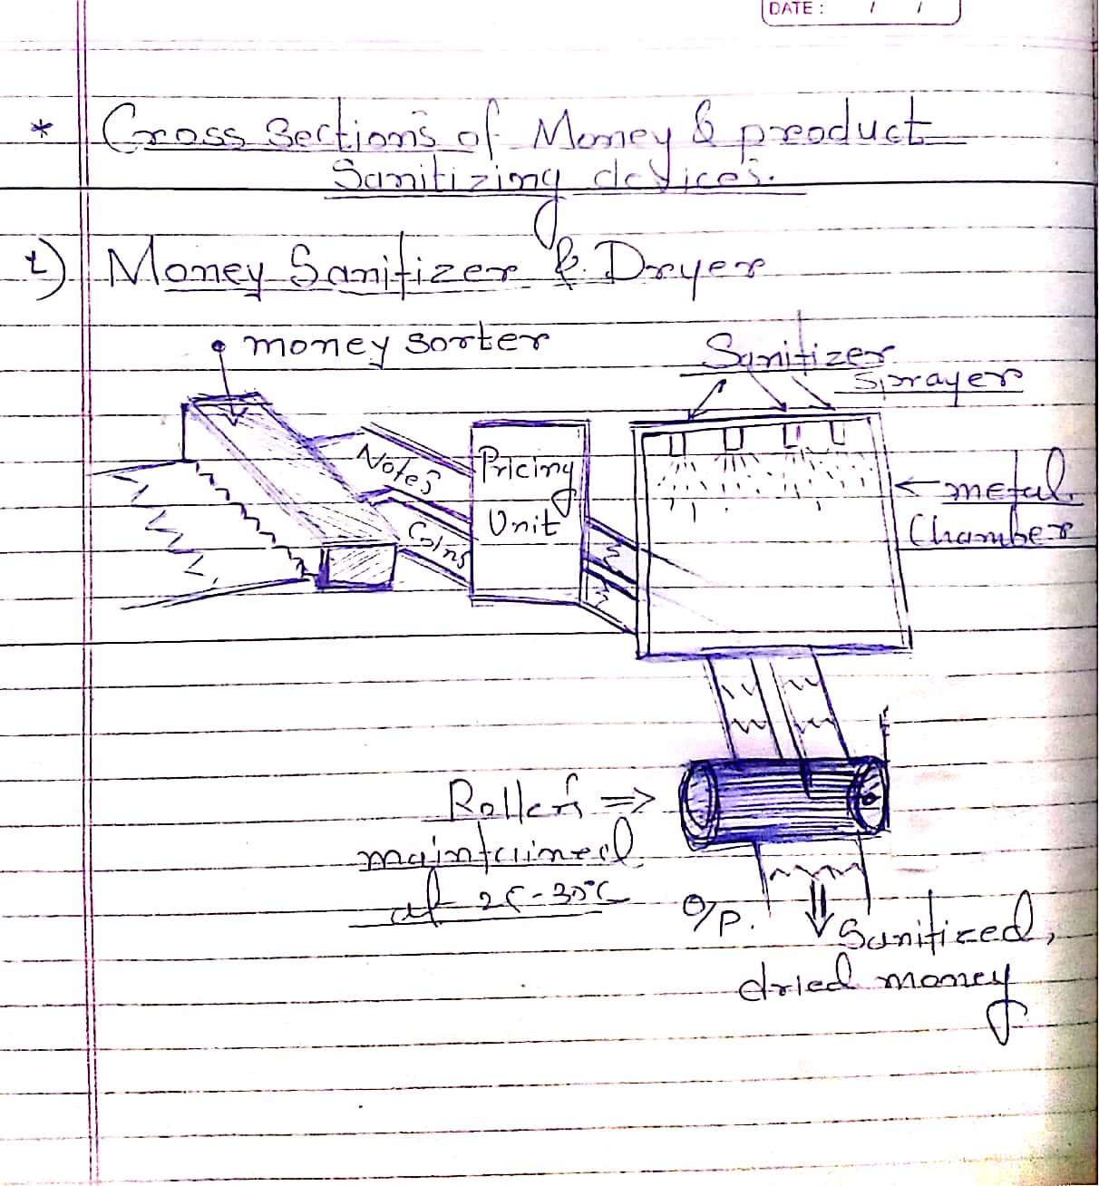
THIS IS HOW OUR DEVICE WORKS

Slide 4
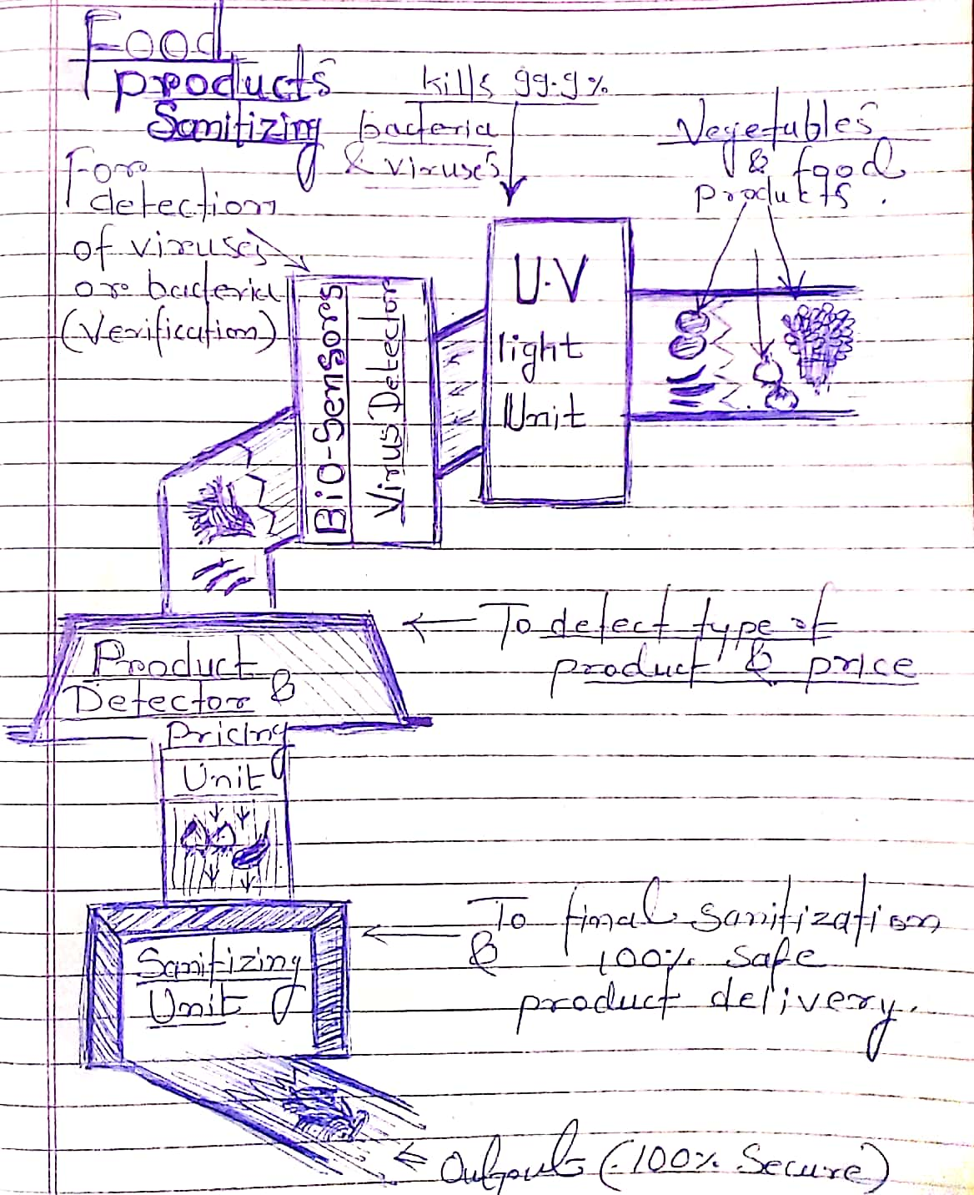
Our food.products sanitizing device..

Slide 5
COMPONENTS...
Conveyor Belts
Money Sorter/ Product dectector.
Pricing Unit.
Sanitizing Unit [sprayers]
Hot rollers [maintained at 25-30C[for money sanitizing purpose only]

Slide 6
WORKING...
Here we are with a machine which sanitizes the varous products as well as money.
PRODUCT SANITIZING UNIT.
At first the product which is to be sanitised is first placed on conveyor belt then it goes through 'PRICING UNIT' where the price of product is detected.
Then the product goes through sanitizing chamber maintained at 25-30C which sanitizes the product and now the product is safe to deliver to the buyers.

Slide 7
WORKING...
MONEY SANITIZING UNIT.
At first, put money on coveyor belt then they goes through seperator where separation of money takes place [i.e coins and notes].
After seperation the money goes through the pricing unit where amount is calculated.
Once the amount is calculated, they passed through 'SANITIZING ' chamber where they gets disinfected and then notes are allowed to pass through hot rollers maintained at 25-30C.
Due to this they are perfectly snitize and safe to deliver.

Slide 8
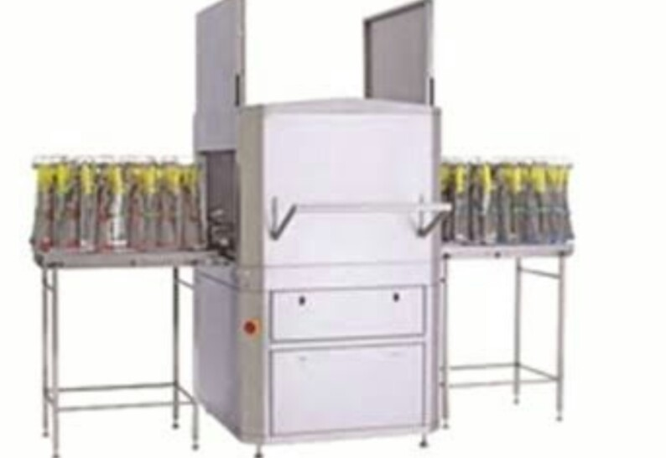
Sanitizing
Chamber..

Slide 9
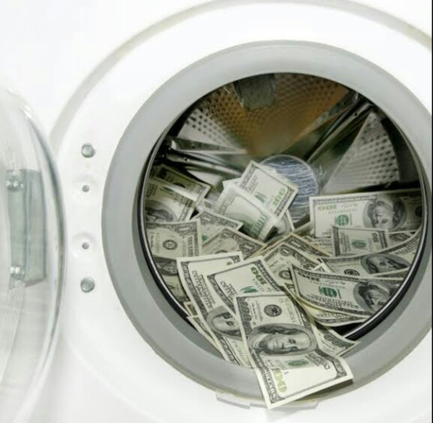
STAY SAFE, STAY HEALTHY''
THANKYOU...

